Slide 1

Spring Boot Part 1

Slide 2
Agenda
Server Side Rendering vs Client Side Rendering
Understand REST Web Service
Why Using Spring Boot
Environment Setup
How to create Spring boot web service
Build project into executable jar
Tool to Test the Web Service

Slide 3
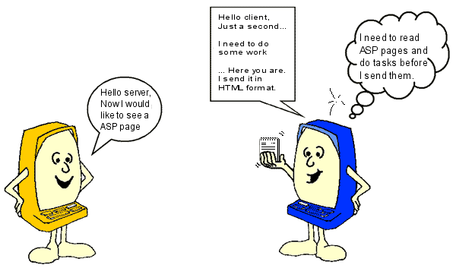
Server Side Rendering Page
Processed on the server before the page is sent to the client's web browser.
ASP/ASPX/JSP

Slide 4
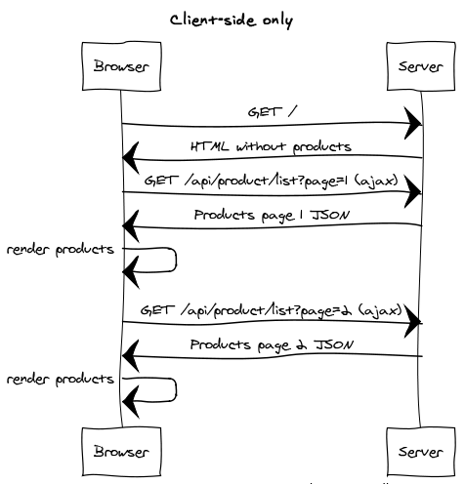
Client Side Rendering Page

Slide 5
What is REST ?
REST stands for REpresentational State Transfer
REST is web standards based architecture and uses HTTP Protocol for data communication
Rest Feature ：
REST is Stateless
They don't persist any state between requests from the client. i.e. the service doesn't know, nor care, that a subsequent request came from client that has/hasn't made a previous request. Basically, its a 'give me this piece of info and forget about me' which puts the onus on the client to maintain any state.
REST is Cacheable
Caching refers to storing server response in client itself so that a client needs not to make server request for same resource again and again.

Slide 6
Why use REST ?
REST Benefits：
Light weight
Highly scalable
Maintainable
Cross platform access data
RESTful Web Services are REST architecture based web services

Slide 7
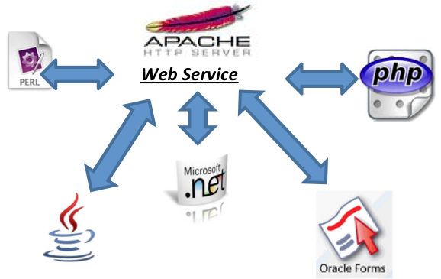
Restful Web services are not tied to any one operating system or programming language.
java can talk with Perl
Windows applications can talk with Unix applications

Slide 8




Who Use REST ?

Slide 9
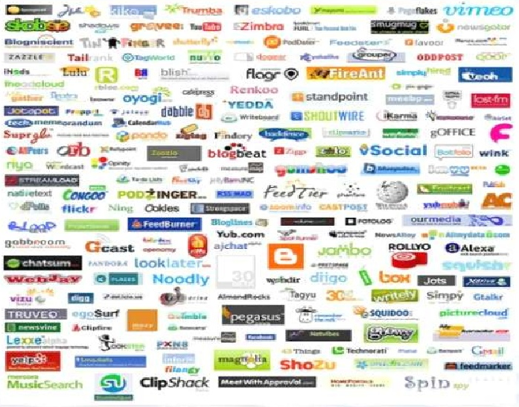
Who Use REST ?

Slide 10
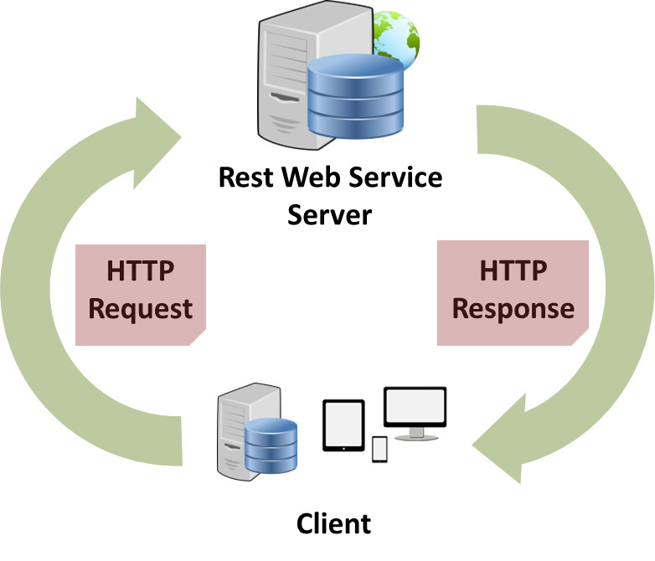
How REST Communicate
RESTful web services make use of HTTP protocol as a medium of communication between client and server.
A client sends a message in form of a HTTP Request and server responds in form of a HTTP Response.
REST uses various representations to represent a resource like JSON and XML.
Now a days JSON is the most popular format being used in web services.

Slide 11
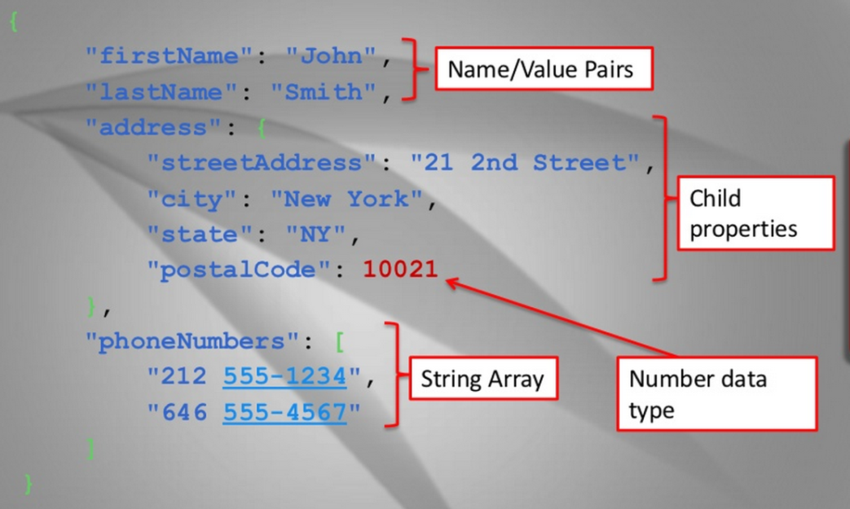
JSON
JSON stands for JavaScript Object Notation
JSON benefits：
Lightweight
Text-based
Easy to Read
JSON Syntax Rules
Data is in name/value pairs
Data is separated by commas
Curly braces hold objects
Square brackets hold arrays
JSON values can be:
A number (integer or floating point)
A string (in double quotes)
A Boolean (true or false)
An array (in square brackets)
An object (in curly braces)
Null

Slide 12
HTTP Methods
Following well known HTTP methods are commonly used in REST based architecture.
POST - Used to update a existing resource or create a new resource.(Create)
GET - Provides a read only access to a resource.(Read)
PUT - Used to update a resource.(Update)
DELETE - Used to remove a resource.(Delete)
Example
No. | HTTP Method | URI | Operation
1 | GET | /UserService/users | Get list of users
2 | GET | /UserService/users/1 | Get User with Id 1
3 | PUT | /UserService/users/2 | Update User with Id 2
4 | POST | /UserService/users/2 | Insert User with Id 2
5 | DELETE | /UserService/users/1 | Delete User with Id 1

Slide 13
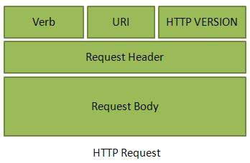
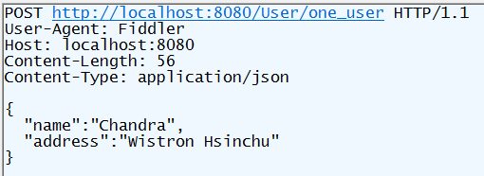
Example – HTTP Request

Slide 14
HTTP Response Code
Status Code
The Status-Code element is a 3-digit integer where first digit of the Status-Code defines the class of response and the last two digits do not have any ategorization role.
There are 5 values for the first digit：
Code | Description
1xx | Informational It means the request was received and the process is continuing.
2xx | Success It means the action was successfully received, understood, and accepted.
3xx | Redirection It means further action must be taken in order to complete the request.
4xx | Client Error It means the request contains incorrect syntax or cannot be fulfilled.
5xx | Server Error It means the server failed to fulfill an apparently valid request.

Slide 15
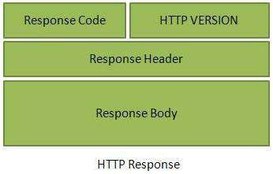
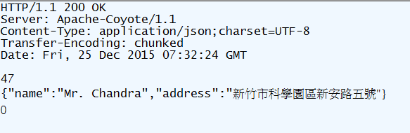
Example - HTTP Response

Slide 16
RESTful URL Design
A URL is of following format：
<protocol>://<service-name>/<ResourceType>/<ResourceID>
Following are important points to be considered while designing a URI：
Use Plural Noun - Use plural noun to define resources. For example, we've used users to identify users as a resource.
Avoid using spaces - Use underscore(_) or hyphen(-) when using a long resource name
for example, use authorized_users instead of authorized%20users.
Use lowercase letters - Mixed case can be harder to type in. Upper- and, arguably, mixed-case can be less readable. Mixed case may also cause ambiguity
USER_service ➔ user_service
Do Not Use HTTP Verb - It is not good to use operations names in URI.

Slide 17


URL Example
Bad Example :
http://localhost:8080/AddUser?id=1
http://localhost:8080/DeleteUser? id=1
http://localhost:8080/EditUser? id=1
http://localhost:8080/GetUser? id=1
Good Example:
POST
GET
DELETE
UPDATE
http://localhost:8080/user_service/users/1

Slide 18
Maven Introduction
Maven is a Java tool, so you must have Java installed in order to proceed.
Maven is tool with multiple facets：
A BUILD tool
A DEPENDENCY MANAGEMENT tool
A DOCUMENTATION Tool
Before Maven, it was really hard to find java libraries, and harder to ensure a coherent use of these libraries.

Slide 19
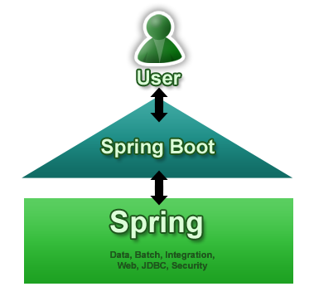
Why Using Spring Boot
Spring Boot aims to make it easy to create Spring-powered, production-grade applications and services with minimum fuss.
Benefits：
Easy to Create stand-alone Spring applications
Embed Tomcat directly (no need to deploy WAR files)
Provide opinionated 'starter' POMs to simplify your Maven configuration
Automatically configure Spring whenever possible
Provide production-ready features such as metrics, health checks and externalized configuration

Slide 20
Spring Boot Basic Components
License | Apache 2
HTTP | Tomcat¹
REST | Spring MVC ²
JSON | Jackson ³
Templates | JSP ⁴
WebSockets | Spring API
DB/ORM | Spring Data
Auth | Spring Security
¹ Spring Boot also supports Jetty. ² Spring also supports JAX-RS using Jersey. ³ Spring can be configured to use Gson instead of Jackson. ⁴ Other available template engines may include Freemarker, Velocity, Thymeleaf, Tiles, Handlebars, and Jade.

Slide 21
Spring Boot Environment
Install JDK 1.8 or later
Spring Tool Suite (STS)
Tomcat → if you want to run WAR file

Slide 22
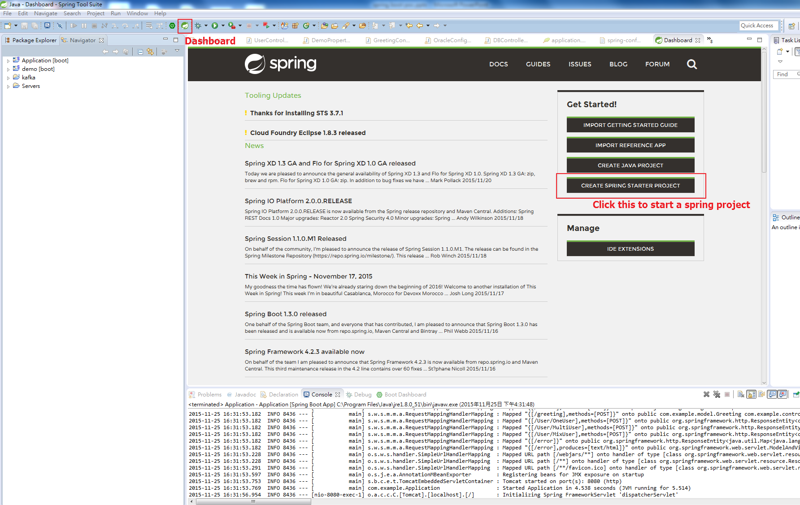
Create Spring Boot Project
Create Spring Starter Project
Download IDE at https://spring.io/tools

Slide 23
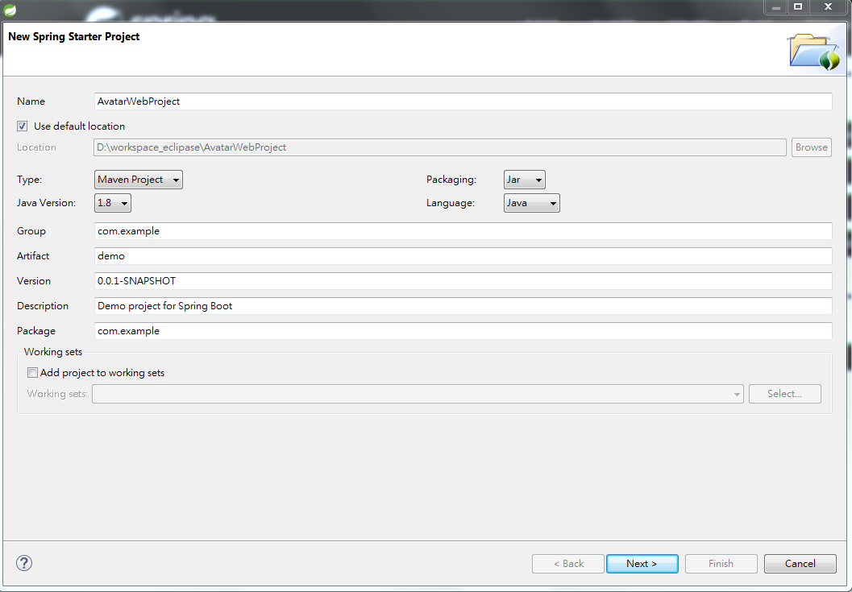
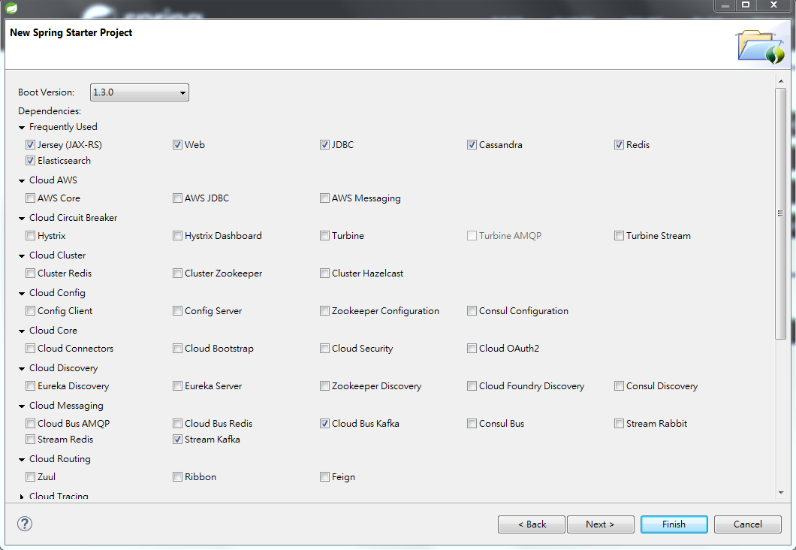
Continues…

Slide 24
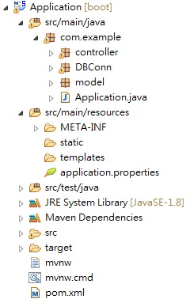
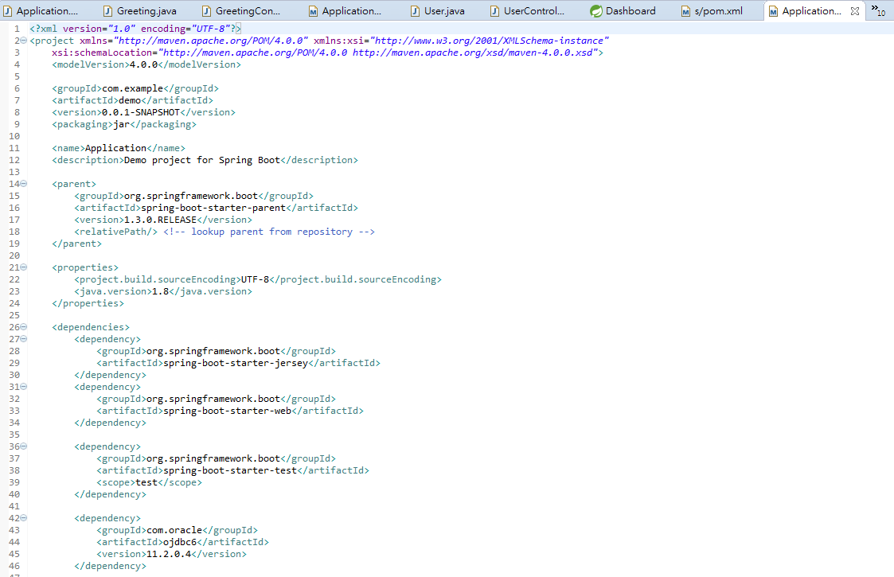
Automatically create pom.xml

Slide 25
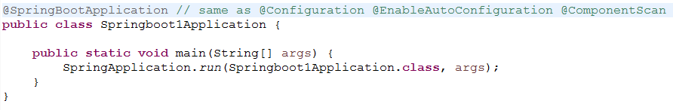
Demo
SpringbootApplication.java
Annotations
Annotations were introduced in Java in the J2SE update 5 already and the main reason was the need to provide a mechanism that allows programmers to write metadata about their code directly in the code itself.
Annotations can be used within packages, classes, methods, variables and parameters.

Slide 26
Demo

Slide 27
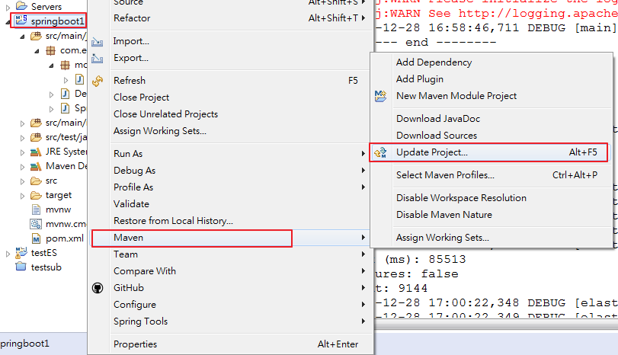
Build Project Into Executable Jar
Maven Update Project first

Slide 28
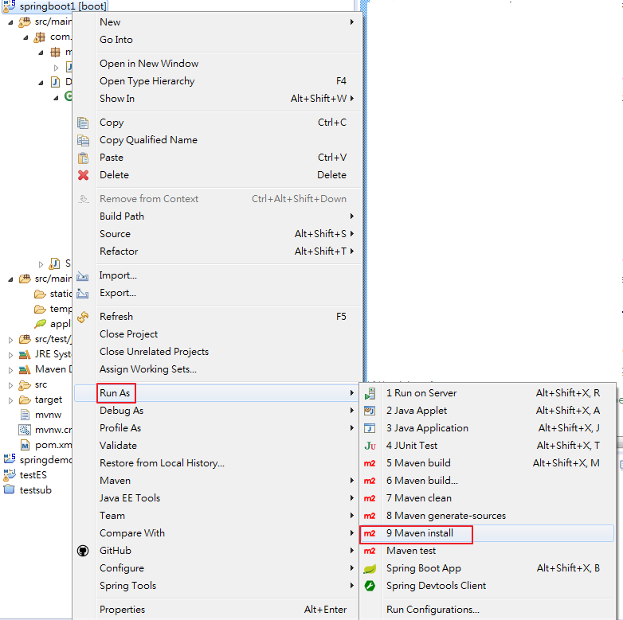
Continue
2. Run as Configuration

Slide 29
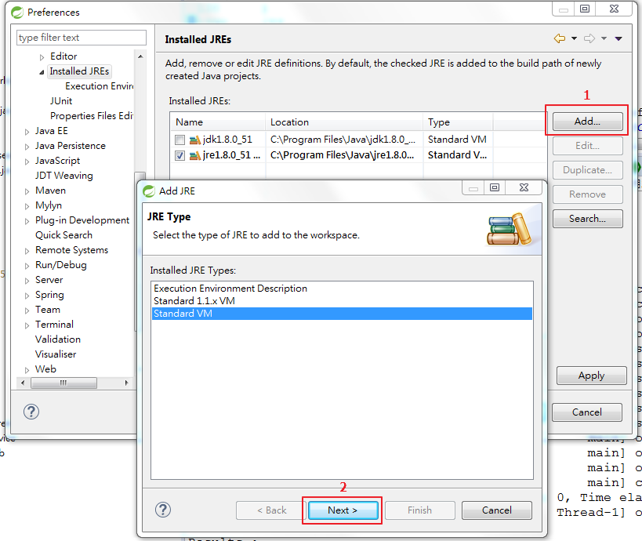
Error handling
[ERROR] Failed to execute goal org.apache.maven.plugins:maven-compiler-plugin:3.1:compile (default-compile) on project mrpapp: Compilation failure [ERROR] No compiler is provided in this environment. Perhaps you are running on a JRE rather than a JDK?
1

Slide 30
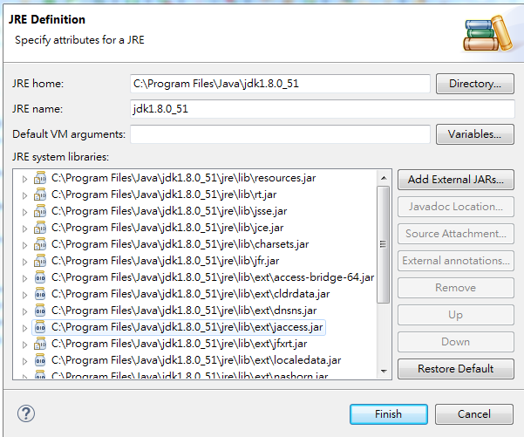
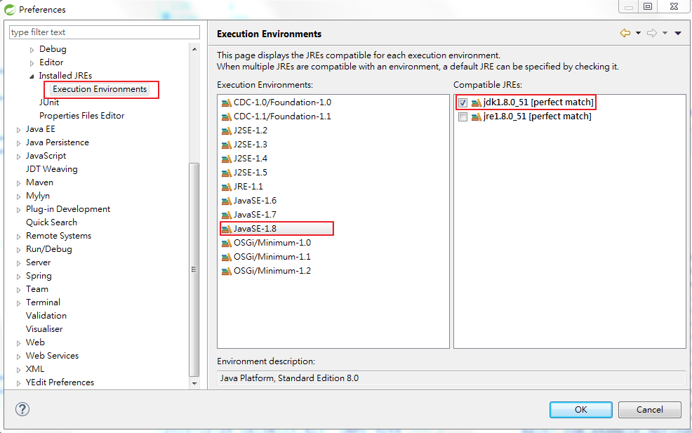
2
3

Slide 31
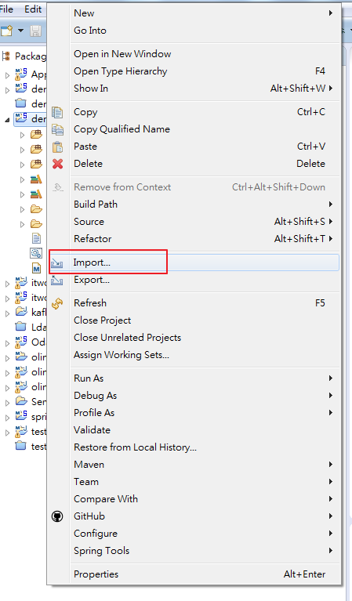
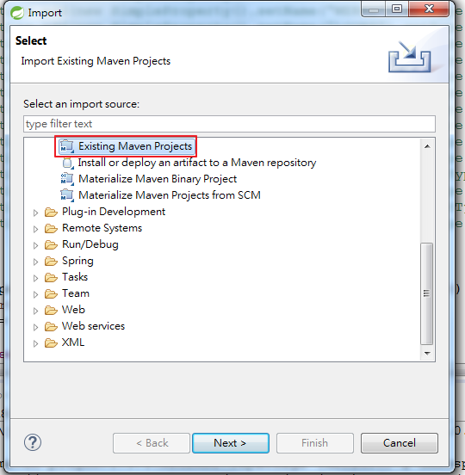
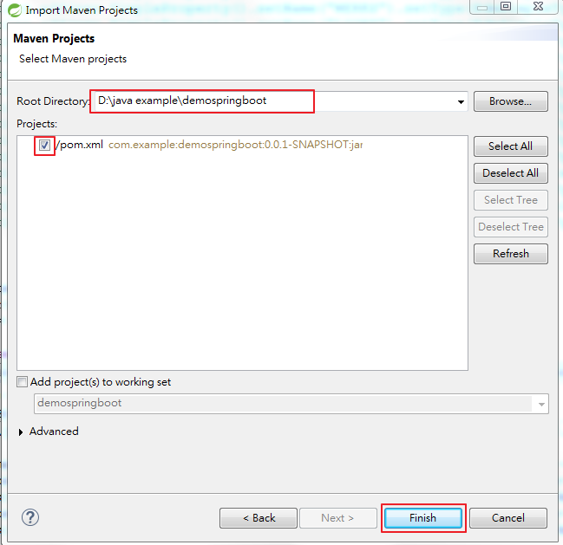
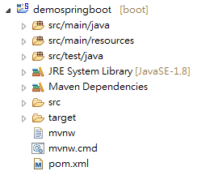
Import Maven Project Zip File

Slide 32
Tool for Testing WebService
Fiddler - http://www.telerik.com/download/fiddler

Slide 33
Homework
Create Spring boot Project with
Controller ,
User model (id , name,site,department,message)
for processing request and response back to client.
Use POST
If client request your ID then use model to response back your data like id , name, site, and department
If client request is not your Id then response back error message with No Data Found
Use GET
Send request to server with your ID in it and response back your data like id, name, site and department

Slide 34
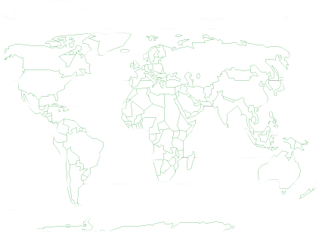

Thank You !

